Slide 1
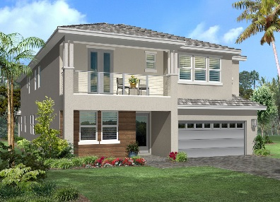
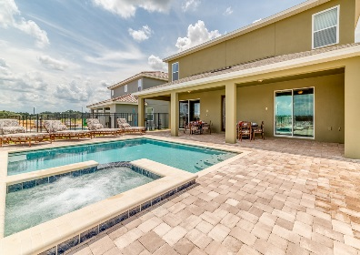
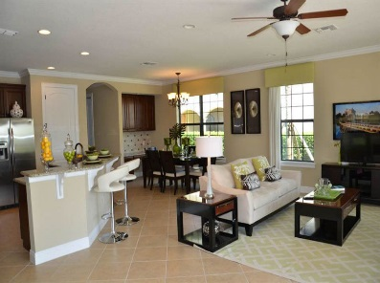
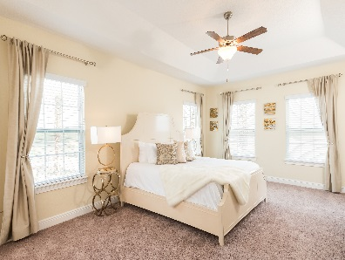
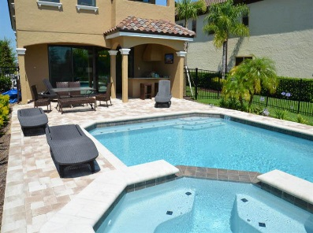
Specific Communities
Encore at Reunion
Brand New Homes within this Exclusive Gated Community opening May 2016
5 - 13 Bedroom homes, all with private pools & lanai’s, Full Kitchen, Dining & Living Areas
Complimentary Wi-Fi
Club house with Restaurant, Bar, Lounge and Fitness Centre
Zero entry swimming pool with slides and children’s splash area
Request Only: Games Room or Spa
Resort Fee
Encore has a $25 + Tax Per Day Resort Fee, but includes the following;
Themepark Shuttles to Walt Disney World twice a day and Universal Orlando Resort once a day
Encore Club House Access, Encore’s 10-acre Water Park, Encore’s 5 Restaurants, Fitness Centre and Inter-resort transfers
Pool Heat
$50 Per Day
Important Info:
Encore is a ‘cashless’ resort. All clients staying at Encore will need to top-up a pre-paid card
Clients checking-in to an Encore home will need to go to the Ocean Holidays Welcome Centre
Guests staying at Encore do not have automatic access to Reunions Water Park or Golf, however can use other facilities at Reunion.
Location:
7 Minutes from Walt Disney World Resort
20 Minutes from Universal Studios
25 Minutes from International Drive
35 Minutes from Orlando International Airport
Video Link:
https://www.youtube.com/watch?v=fRU1_NtmCfc
Notes:
1

Slide 2
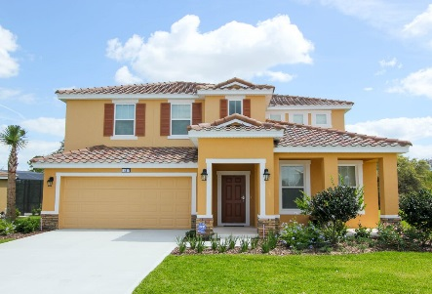
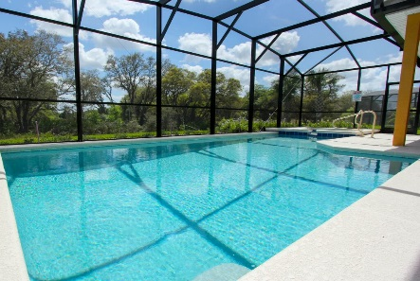
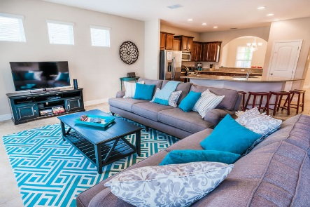
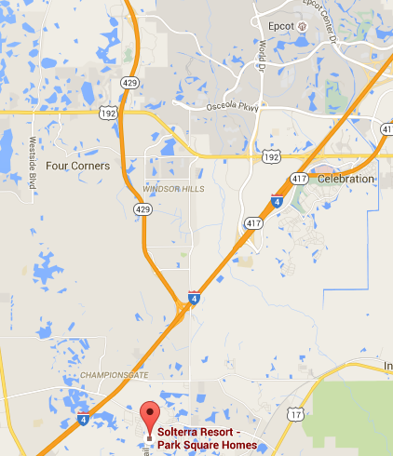
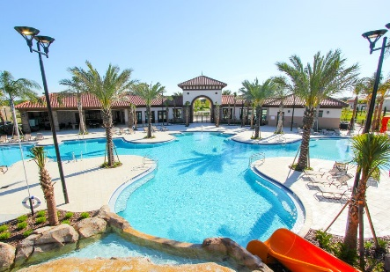
Specific Communities
Solterra Resort
Offered: Platinum Homes
Brand new homes within a new exclusive gated resort
5, 6 & 7 Bedroom homes, all with private pools
Features Full Kitchen, Dining and Living Areas
Free Wi-Fi & Games Room or Spa
Clubhouse & Communal Swimming Pool
Tennis Courts, Beach Volleyball, Walking trail
Gas and Electric Pool Heat (Quote based on Gas)
Location:
18 Minutes from Walt Disney World Resort
25 Minutes from Universal Studios
20 Minutes from International Drive
45 Minutes from Orlando International Airport
I-4 located just 10 minutes away
Tip:
Similar location to West Haven & homes are of a similar
Standard to Championsgate/Paradise Palms
Video Link:
https://www.youtube.com/watch?v=wQGrxwAtIak
Notes:
2

Slide 3
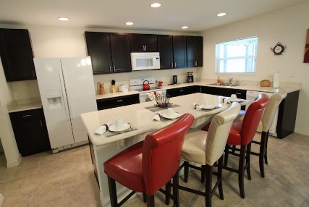
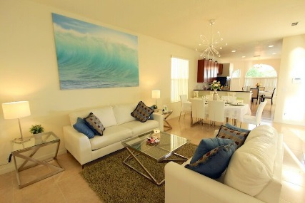
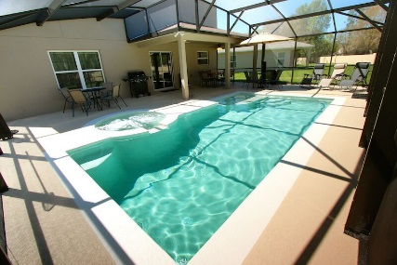
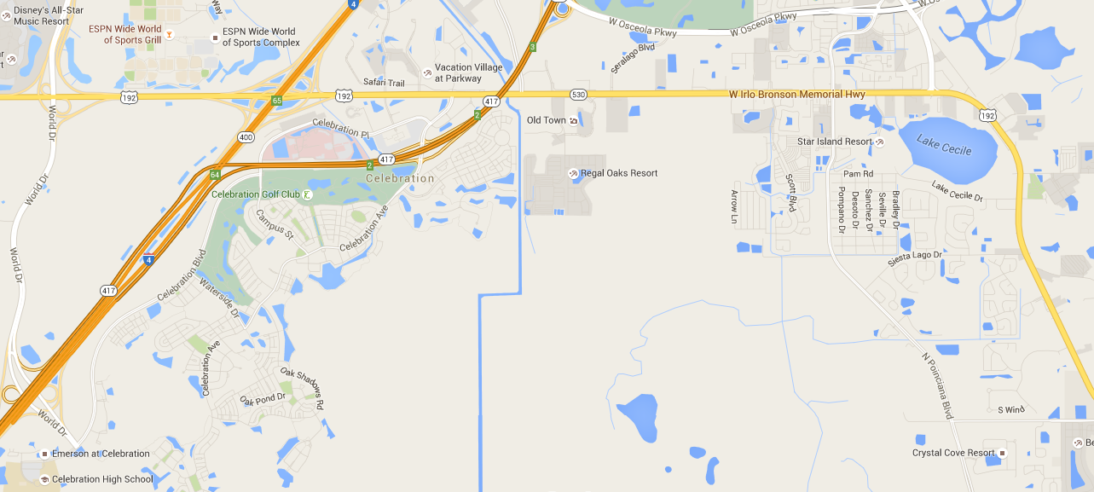
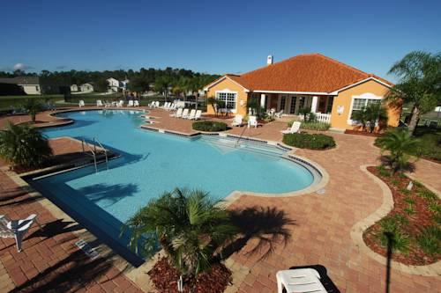
Specific Communities
Crystal Cove
Offered: Platinum Homes
Platinum homes within a gated community
Built in around 2011 (Slightly newer than Trafalgar Village)
4, 5 & 6 Bedroom homes, all with private pools
Features Full Kitchen, Dining and Living Areas
Free Wi-Fi & Games Room or Spa
Electric Pool Heat
Location:
14 Minutes from Walt Disney World Resort
25 Minutes from Universal Studios
20 Minutes from International Drive
45 Minutes from Orlando International Airport
I-4 located just 14 minutes away
Close to a Walmart
Tip:
Similar quality to Windsor Hills Platinum.
Recommended as a good upgrade from Trafalgar.
Video Link:
https://www.youtube.com/watch?v=AUmkDmHFl04
Notes:
3

Slide 4
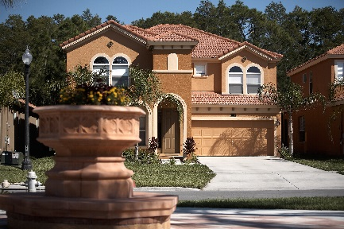
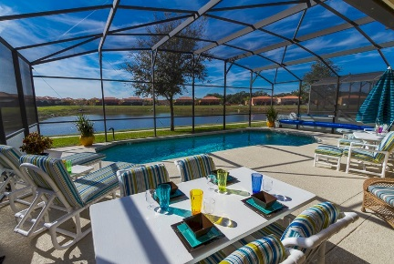
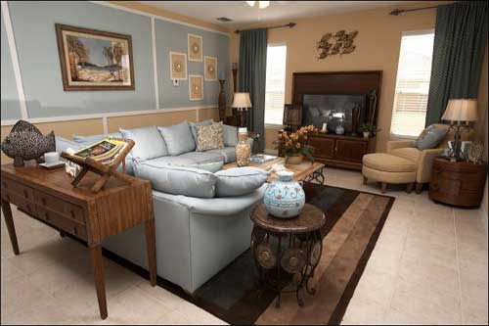
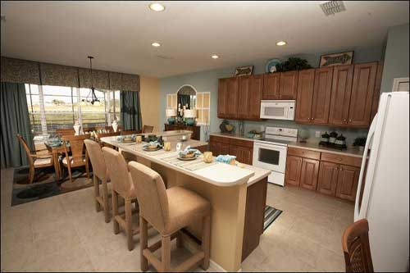
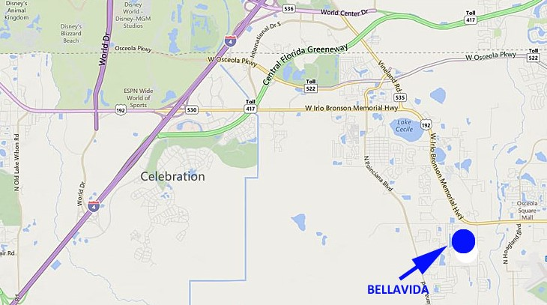
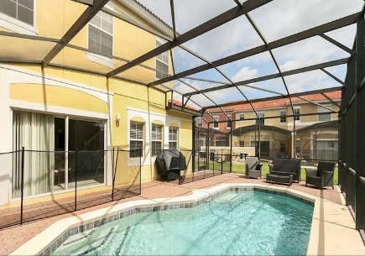
Specific Communities
Bellavida
Offered: Platinum Homes
Platinum homes within a gated community
Built in around 2008 (Same age as Trafalgar Village)
4, 5 & 6 Bedroom homes, all with private pools
3 Bed Townhome with Splash Pool & 4 Bed Townhome with Pool
Features Full Kitchen, Dining and Living Areas
Free Wi-Fi & Games Room or Spa
Gas Pool Heat
Location:
14 Minutes from Walt Disney World Resort
25 Minutes from Universal Studios
20 Minutes from International Drive
45 Minutes from Orlando International Airport
I-4 located just 14 minutes away
Close to a Walmart
Tip:
Similar quality to Windsor Hills Platinum.
Recommended as a good upgrade from Solana.
Video Link:
https://www.youtube.com/watch?v=nvWKfTXGZPw
Notes:
4

Slide 5
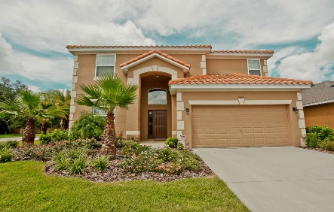
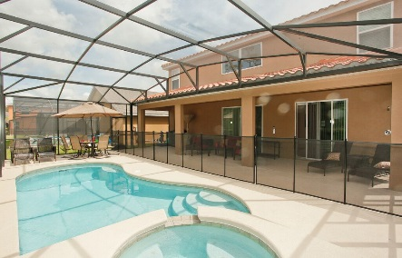
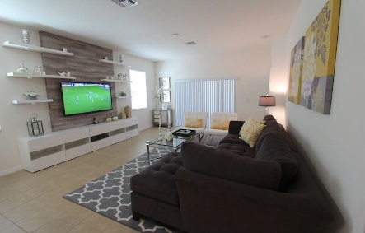
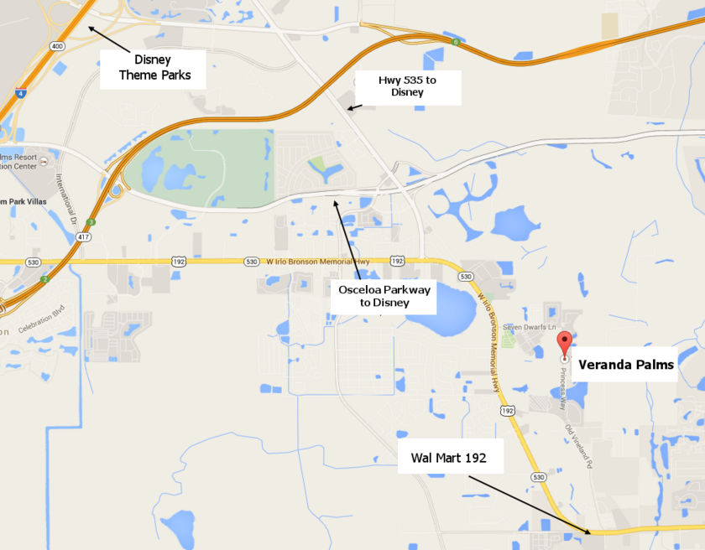
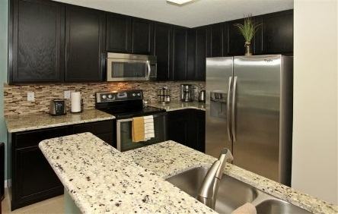
Specific Communities
Veranda Palms
Offered: Platinum Homes
Brand new homes within a new resort (gated from 2016)
4, 5 & 6 Bedroom homes, all with private pools
Features Full Kitchen, Dining and Living Areas
Free Wi-Fi & Games Room or Spa
Clubhouse to be open from 2016
Gas Pool Heat
Location:
13 Minutes from Walt Disney World Resort
25 Minutes from Universal Studios
20 Minutes from International Drive
45 Minutes from Orlando International Airport
I-4 located just 10 minutes away
Tip:
Similar location to Bellavida. Recommended as a good
Upgrade from Calabay Parc style of home
Video Link:
https://www.youtube.com/watch?v=cPuH_s3By6Q
Notes:
5

